Slide 1

BRIGHT COFFEE SHOP
Sales Performance & Data Analysis
Databricks | Excel | Data Studio | Power BI
Presented by: Sinazo Mgingqi
September 2026

Slide 2
Understanding the Business Problem
Objective:
Analyse Bright Coffee’s historical sales data to identify revenue drivers, product performance and customer purchasing patterns, and provide actionable recommendations to support business growth.
☕ Product
Which products and categories generate the most revenue?
⏰ Time
When are customers generating the most revenue?
📈 Trends
How does revenue change over time?
💡Action
What opportunities can be identified from the data?

Slide 3
Data Preparation and Analysis Approach
Raw Dataset
↓
Data Cleaning
↓
Data Transformation
↓
Analysis
↓
Visualisation
↓
Business Insights
Cleaned missing/blank product categories and product types
Converted unit price into a numeric format
Calculated total revenue
Created day, month and time fields
Created time periods and classifications
Validated transaction and revenue calculations
Tools Used
SQL / Databricks → Data preparation
Excel → Initial analysis & dashboard
Data Studio → Interactive visualisation
Power BI → Advanced analysis & reporting
Databricks- Analysis Dashboard

Slide 4
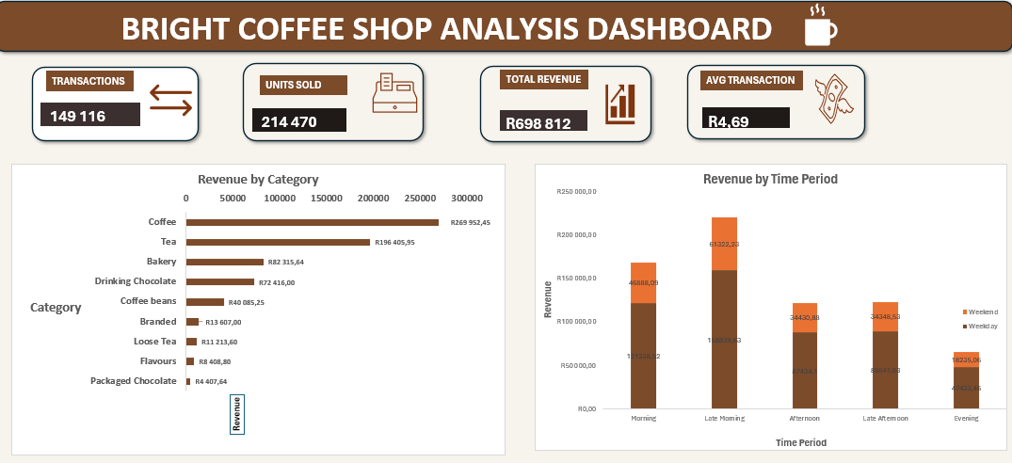
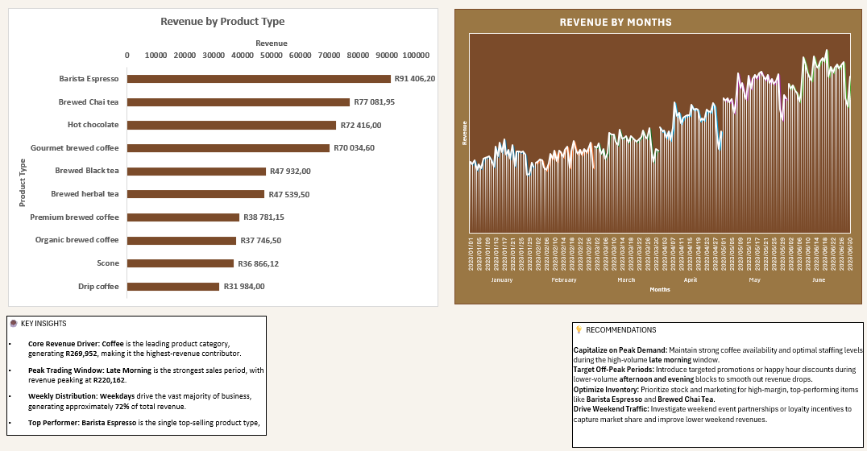
Excel Dashboard
Key message:
Excel provided the first visual exploration of the cleaned dataset and helped identify initial sales patterns.
Excel Dashboard
Notes:
ExceL was used to :
Create KPI summaries
Analyse revenue by category
Analyse product performance
Analyse time periods
Analyse weekday/weekend performance
Explore the data using slicers

Slide 5
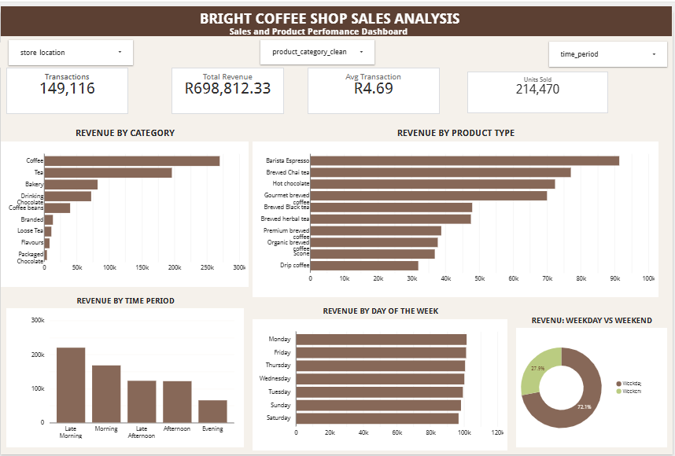
Data Studio- Dashboard
Notes:
*Data Studio was used transformed the analysis into an interactive reporting experience that allows users to explore the data dynamically.
*Interactive filters are added so they can be used to inspect store locations, product categories and time period independently
Revenue analysis
Product performance
Time analysis
Day-of-week analysis

Slide 6
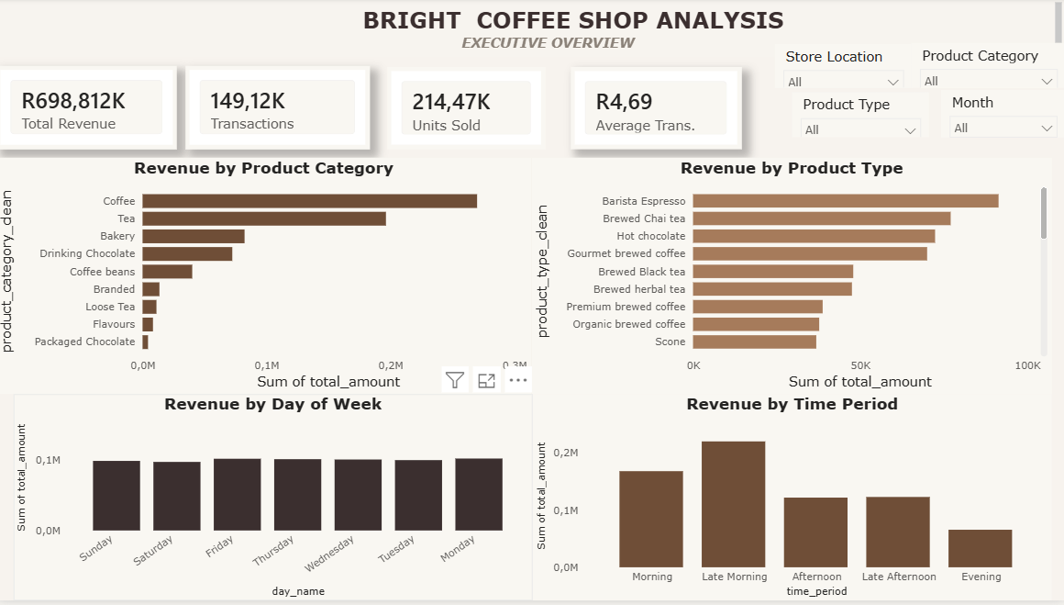
Power BI - Dashboard

Slide 7
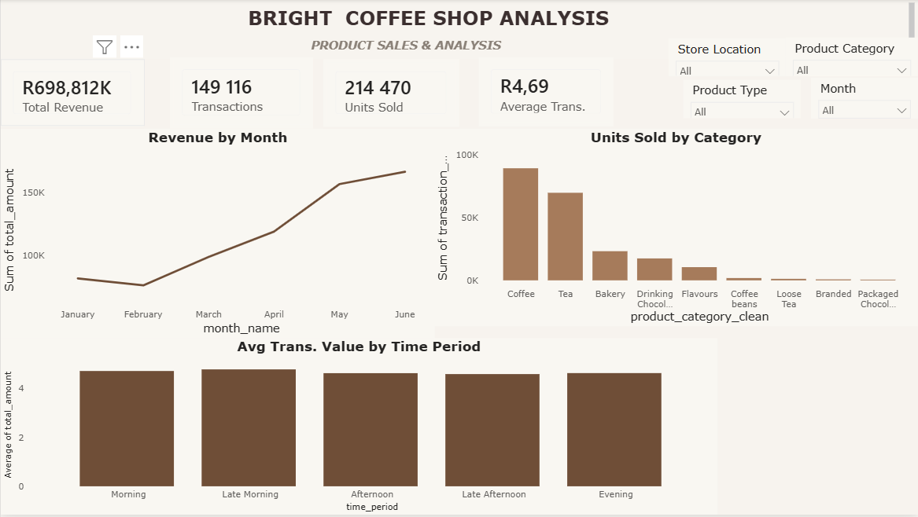
Notes:
Key message:
Power BI enabled deeper analysis and a structured two-page dashboard for monitoring sales performance.

Slide 8
Key Business Insights
Peak Trading Period
Revenue
R220,162
Late Morning (09:00-11:59) recorded the highest revenue among the analyzed three-hour periods.
Top Revenue Category
R269,952
Coffee generated the highest category revenue.
Weekday Revenue
R503,588
Weekdays contributed approximately 72% of the total revenue.
Leading Product Type
R91,406
Barista Espresso was the highest-revenue product type in the analysis

Slide 9
Turning Insights into Action
Next Steps
Four practical opportunities to strengthen sales performance
1. Prioritise High-Performing Products
Maintain availability of popular coffee products, especially Barista Espresso, and evaluate opportunities to increase complementary purchases.
2. Optimise Peak Trading Hours
Review staffing, stock levels and service speed during the strongest revenue periods, particularly late morning.
3. Build Weekend Sales
Test targeted promotions and product bundles to encourage additional weekend visits and purchases.
4. Monitor Performance Continuously
Use the interactive dashboards to track revenue, product performance, store differences and changes in customer purchasing patterns.

